Slide 1
Algoritma & Pemrograman
Pointers
Prepared by
Frans Panduwinata, S.Kom, M.T

Slide 2
Address
For every variable declared in a program there is some memory allocation.
Memory is specified in arrays of bytes, the size of which depending on the type of variable.
EXAMPLE:
For the integer type, 2 bytes are allocated,
for floats, 4 bytes are allocated, etc.

Slide 3
Address (cont)
Each variable has two attributes: address and value.
The address is the location in memory where the value of the variable is stored.
During the lifetime of the variable, the address is not changed but the value may change.

Slide 4
Pointers
A pointer is a variable whose value is also an address.
Pointers give a facility to access the value of a variable indirectly.
You can define a pointer by including a* before the name of the variable.
For EXAMPLE: int *ia;
You can get the address where a variable is stored by using &.
For EXAMPLE: ia = &i;

Slide 5

Pointers (cont)
EXAMPLE:
#include <iostream.h>
main ()
{
int i;
int *ia;
i = 10;
ia = &i;
cout <<" The address of i is “<<ia<<endl;
cout <<" The value at that location is “<< i<<endl;
cout <<" The value at that location is “<<*ia<<endl;
*ia = 50;
cout <<"The value of i is “<<i<<endl;
}

Slide 6
Call by Reference
In C++ the effect of passing a parameter by reference is achieved by passing a pointer to data rather than the data itself.
For EXAMPLE, if a functions header appears as
void fun (int *p)
then the function will expect to receive a pointer to an integer rather than an integer itself. In turn, the statement
*p = 5;
within the function will assign the value 5 to the location pointed to by p—that is, to a location in the calling environment.

Slide 7
Call by Reference (cont)
EXAMPLE:
#include <iostream.h>
void rect_area(float, float, float*);
void main()
{
float width = 2.5, height = 3.1, area = 0.0;
rect_area(width, height, &area);
cout << "The area in main is " << area << endl;
}
void rect_area(float width, float height, float *area)
{
*area = width * height;
cout << "The area in the function is " << *area <<endl;
}

Slide 8
Pointer Arithmetic
The value of a pointer can be adjusted by means of normal arithmetic expressions.
The following are all valid examples of pointer arithmetic:
p++ --p p + 5 p – 2 p + i
The pointer is changed according to the size of the data item being pointed to.
Incrementing a pointer to data of type integer should adjust the pointer to point to the next integer in memory.

Slide 9
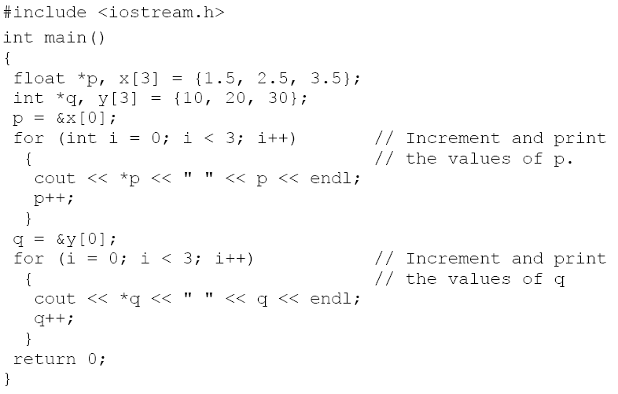
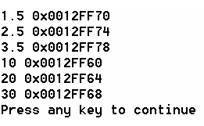
Pointer Arithmetic (cont)
EXAMPLE:

Slide 10
Pointer Arrays
You can define a pointer array similarly to an array of integers.
In the pointer array, the array elements store the pointer that points to integer values.

Slide 11
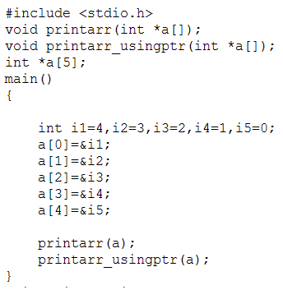
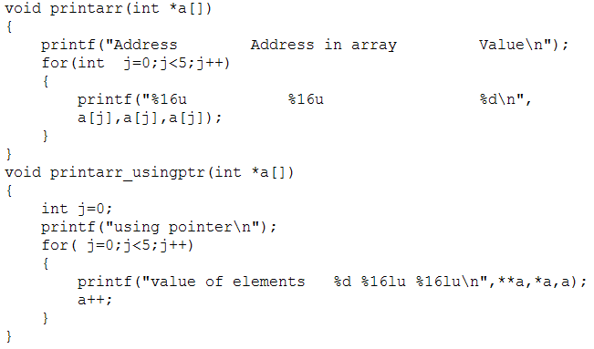
Pointer Arrays (cont)
EXAMPLE:

Slide 12
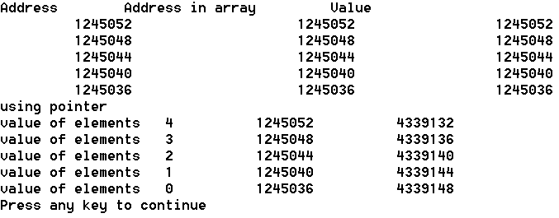
Pointer Arrays (cont)
Screen output:
a is the address of the array element,
*a is the value of the array element, and
**a is the value pointed to by this array element.

Slide 13
Dynamic Memory Allocation
You can use an array when you want to process data of the same data type and you know the size of the data.
Sometimes you may want to process the data but you don't know what the size of the data is.
You can allocate memory at runtime by using the function malloc in C++.
When your work is over, You can deallocate the memory by using the function free.

Slide 14
Dynamic Memory Allocation (cont)
EXAMPLE:
int *base;
int cnt;
cout <<"how many integers you have to store “<<endl;
cin>>cnt;
base = (int *)malloc(cnt * sizeof(int)); //allocate memory
.
.
free(base); //deallocate memory

Slide 15
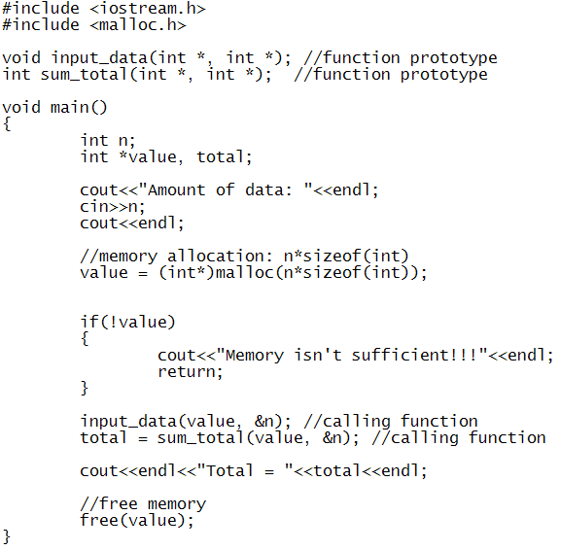
Dynamic Memory Allocation (cont)
EXAMPLE:

Slide 16
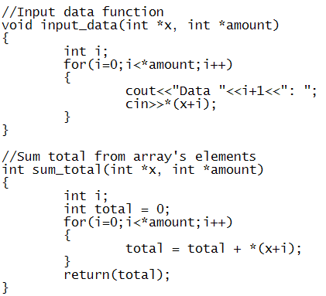
Dynamic Memory Allocation (cont)
EXAMPLE: (cont)

Slide 17
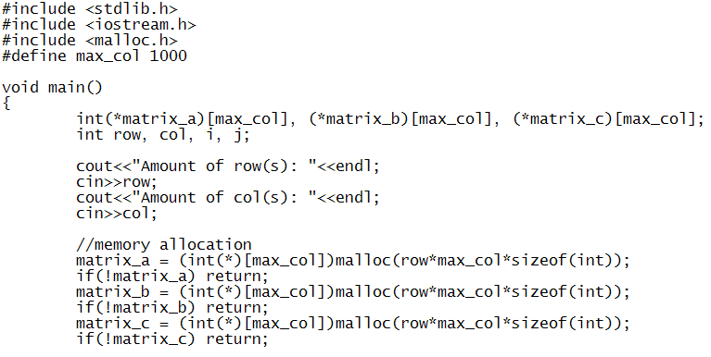
Pointer Array 2-D
EXAMPLE:

Slide 18
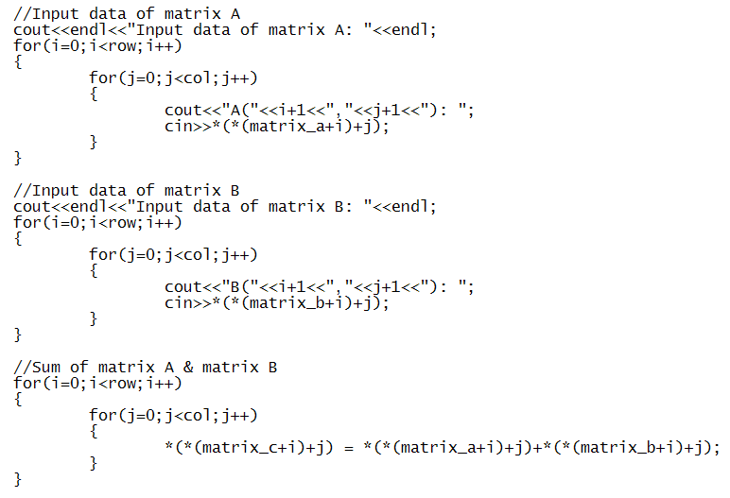
Pointer Array 2-D (cont)
EXAMPLE:
(cont)

Slide 19
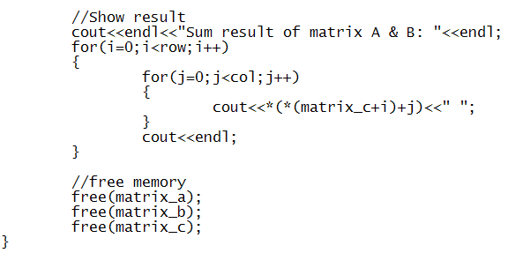
Pointer Array 2-D (cont)
EXAMPLE: (cont)

Slide 20
Exercises
Write a program using pointers and functions.
Number of Row(s) : 3
Number of Column(s): 3
Input data
.
.
.
Your Data:
7 9
3 10
7 12
Max number in row 1: 9
Min number in row 1: 5
.
.
.

